Slide 1

Regional Comprehensive Economic Partnership
Student’s Name
University
Professor’s Name
Date
Notes:
The presentation will focus on Regional Comprehensive Economic Partnership (RCEP).

Slide 2
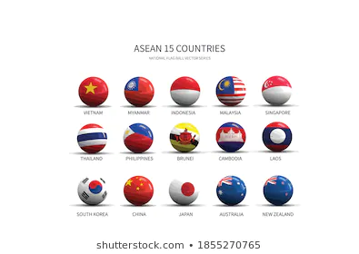
introduction
The Regional Economic Partnership (RCEP) trade agreement event took place on November 15th.
A total of 15 countries in the Pacific and East Asia signed the trade agreement (The Economist, 2020)
This created the largest trading bloc globally
RCEP talks begun in 2012 where 16 countries as well as the 10 Associations of Southeast Asian Nations (ASEAN) countries, India, Australia, China, New Zealand, South Korea and Japan were involved
RCEP is also responsible for Foreign Direct Investment’s 19 percent and services trade’s 18 percent outflows
Notes:
With the increase in globalization and economic interaction within countries, the establishment of free trade has been an ongoing issue, especially in Southeast Asian nations. For that reason, the regional comprehensive economic partnership (RCEP) was established on 15th November 2020 by fifteen countries in East Asia (The Economist, 2020). RCEP is the largest trading bloc in the world being a trade agreement to shape global commerce and politics. Although the talks for RCEP agreement started earlier in 2012, with 16 nations having 10 of the countries in the Association of Southeast Asian Nations (ASEAN) the United States and India withdrew from the agreement. Similarly, RCEP controls 19% of Foreign Direct Investments and 18% of service trade outflows.

Slide 3
The EVENT
The RCEP trade bloc, propelled by China, has attained fame in international investments and trade
Also outrun large high-income trade blocs growth over the past years
The development of Southeast Asian and China’s economies can be related to the rising shares of the RCEP bloc in the world’s trade, GDP and FDI for the past few decades
This is also responsible for propelling RCEP’s overtaking of trading blocs that were huge at the century’s beginning
This include the European Union (EU) and North America Free Trade Agreement (Kuo, 2020)
Notes:
RCEP has emerged as the most influential economic supremacy in Asia-Pacific region. The world economy is supported by trade relations between countries where after China initiated RCEP it has achieved global recognition due to efficiency and outpacing other high-income trade blocs. Furthermore, countries such as China and Southeast Asia are progressing well in their trade because of the connection in increasing shares of the RCEP in the global trade. According to Kuo (2020), RCEP effectiveness has managed to be involved in different large trades in the world hence surpassing huge trading blocs such as the North American Free Trade Agreement together with the European Union.

Slide 4
The Event Cont..
RCEP intensifies investment and trade relations between member nations by reducing its non-tariff barriers (NTBs) on services and goods trade
RCEP concentrates on non-tariff barriers since import tariffs had been minimal between RCEP members even before the signing of the agreement (Kuo, 2020)
Low import tariffs coordinates the facilitation imposed by nations on the marketing of products, giving more assurance to investor and traders
As maybe the most significant feature, the RCEP trade agreement lines up regulations of origin for these 15 countries
As a result, smoothening the integration of the agreement’s participants into the identical chain of production
Notes:
Every investor always concentrates on the enhanced market access. Therefore, RCEP has increased investments and trade associations between countries involved by decreasing the non-tariff barriers on services and goods traded. The main reason for the agreement to focus on non-tariff barriers is because all countries members of RCEP were operating on minimal import tariffs before signing the agreement (Kuo, 2020). Traders and investors benefit from minimized import tariffs because they have assurance on the market of their products. Also, intellectual property rights are important for recognizing the origin of a product or service in the fifteen countries involved because it enhanced agreement integration into a similar production chain.

Slide 5
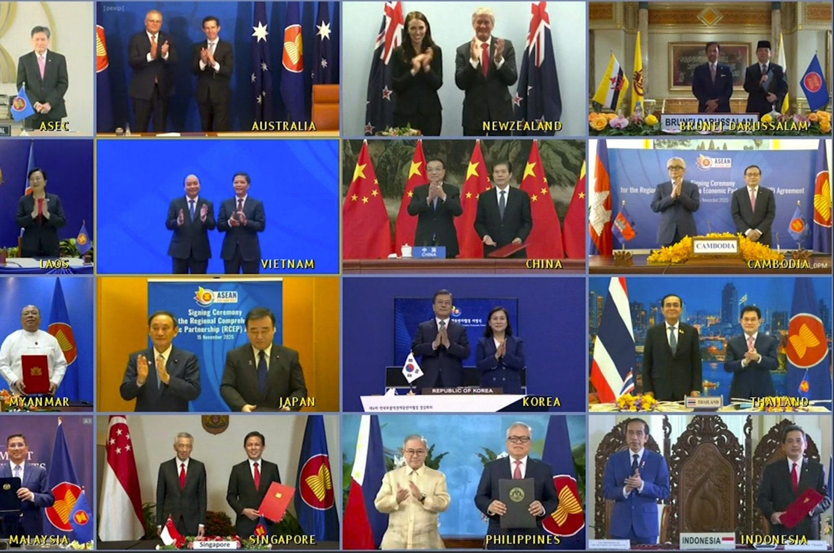
The Event Cont…
This could assist members in attracting an enormous share of global value chains (GVCs)
Also it increase their specialization, which may be significant at a time when China-U.S trade altercation has intensified GVCs’ reconfiguration in and out of China
Relevant provisions in services are also covered by the RCEP (The Economist, 2020)
Notes:
Free trade agreements like RCEP will result in increased production share in the countries involved. Therefore, nations members of RCEP are obtaining an increased share of global value chains (GVC) intensifying their specialization that may be essential at the time when China and the United States disagreements have increased. GVC plays a significant role as it can result in high job creation and economic development of the countries involved. Therefore, with the world bank assisting nations to attain the GVC wave, The Economist (2020), emphasize that RCEP has also covered the relevant provisions in services such as financial services and intellectual property.

Slide 6
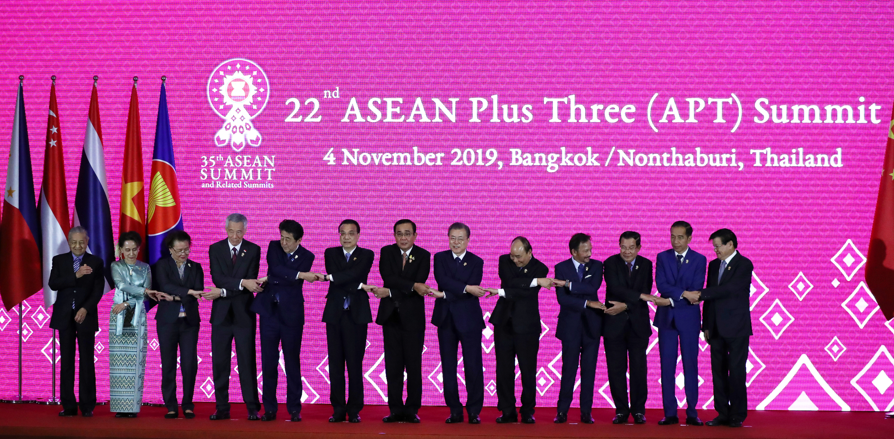
Effects on World Economy
Despite having a significant effect on the global economy, RCEP majorly benefits its country members whereas, gains from different non-members are limited (Kuo, 2020)
Reduction in investment and trade barriers would propel the integration of the economy among the RCEP country members giving way to advantageous gains from trading
The latest model work proposes that by the year 2030, the agreement would propel the trading bloc’s GDP by 0.4 percent
This will include 0.2 percent for members of ASEAN and 0.3 percent growth for China (International Business, 2012)
Notes:
RCEP has significant effects on the world economy considering that the agreement deepens investment and trade associations between nations involved mainly through a decrease in non-tariff barriers on products and services to trade. Kuo (2020) states that RCEP has major paybacks on countries involved where non-members enjoy restricted benefits. While many countries are working to enhance their trade relationship with other nations and providing a good working environment for investors RCEP has contributed to a decrease in investment due to trade barriers hence restricting integration of economies within member countries. According to International Business (2012) projects the agreement will increase the trading blocs GDP by 0.4%, with 0.2% in ASEAN countries and 0.3% for China.

Slide 7
Effects on World Economy Cont…
Therefore, driving the anticipated mild constructive effect of RCEP on the global economy, which is projected to be 0.1 percent of world’s GDP
However, non-members' benefits are likely insignificant
In this entire trade bloc, ASEAN countries may benefit the least from this agreement than the other countries in deeper trade agreements
ASEAN countries possess the least scope to decrease the barriers between them and other members given the current trade agreements’ web, thus, resulting in them gaining fewer benefits between the RCEP members (Dadush & Darandary, 2020)
Notes:
RCEP has developed significantly and it is now overtaking the large trade agreements such as the European Union. This makes it to have a big effect on world GDP. For example, RCEP is anticipated to be 0.1% of world's gross domestic product. Nevertheless, benefits that non-members have in the agreement is insignificant. Similarly, considering the trade bloc wholly, ASEAN nations seem to have minimum benefits compared to other member countries. According to Dadush & Darandary (2020), ASEAN nations have the least choice of reducing barriers between them and other nations regarding present trade agreements hence obtaining fewer benefits between RCEP members.

Slide 8
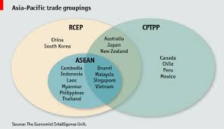
Effects on World Economy Cont…
This makes economies such as Malaysia and Vietnam contemplated to gain more from other agreements such as the Comprehensive and Progressive Agreement for Trans-Pacific Partnership (CPTPP) than from RCEP
These other agreements too are ambitious the same way RCEP is or even more
Therefore, countries such as Indonesia may result in agreeing with other nations in the CPTPP than the RCEP signatories
Notes:
Since RCEP non-members do not benefit the same way as other member countries, it will make the non-member nations be involved in other trade agreements benefiting them more economically. For example, countries such as Vietnam and Malaysia planned to obtain more benefits from other competing agreements such as the Comprehensive and Progressive Agreement for Trans-Pacific Partnership (CPTPP). RCEP faces more competing agreements despite its economic progress. Every country is working to obtain the best economic agreement yielding more benefits hence making nations such as Indonesia collaborate with countries that are part of the CPTPP than those in RCEP signatories.

Slide 9

Effects On World Economy Cont…
The biggest driver for the RCEP appeared to be the fact that United State leader by then, believed that there was no benefit for their country being associated with the large multilateral unchained trade deal (McDonald, 2020)
However, China was very enthusiastic when they thought of a huge multilateral trade deal came up
Since, unlike the US, China save some benefits from this type of trade deals
In China, there is job flow due to cheap labor, therefore, China may be open to free trade according to the US
Notes:
The formation of RCEP was initiated when the leader of United States had a different view concerning the trade and thus believed that there was no advantage gained compared to other multilateral unchained trade deals (McDonald, 2020). This made it challenging as bilateral and plurilateral cannot be substituted with the multilateral trading system. Nevertheless, China was very passionate about the big multilateral deal because compared to the United States, it can gain a lot from the deal due to high job flow leading to cheap labor making them more open to free trade than the United States.

Slide 10

Effects on World Economy Cont…
According to International Business (2012), China having the second-largest economy with $15.26 trillion as its GDP as of 2016 would result in crushing the number one when the RCEP trade agreement picks
Taking into consideration that Japan and India are the third and fourth-largest world economies respectively yet they are all involved in the RCEP (Nytimes. Com, 2020)
Notes:
There is increased economic tension between large countries, as every country is always competing to obtain the best market for their goods and services. Therefore, with an increase in China being involved in large trade agreements, and it has the second-largest economy accounting for 15.26 trillion dollars of GDP based on data of 2016 (International Business, 2012). This would lead to surpassing the leading country when RCEP trade agreement picks. Also, more tension arises because Japan and India the third and fourth-largest economies respectively are part of RCEP agreement making the free trade signatory have a significant impact on the countries involved (NYtimes.com, 2020).

Slide 11
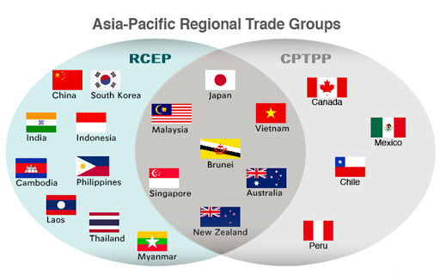
Effects on World Economy Cont…
Currently, the Pacific regions are slowly dominating when it comes to the world economy
With time, they may end up completely dominating globally
In this new era, countries that may like to be involved with the US in trade may face new barriers in duties, tariffs and taxes
This agreement is slowly shifting the tectonic plates of the international economy
The agreement redefines the trade landscape by the creation of a new framework for firms to consider when they are doing business internationally
Notes:
The world economy has been changing every century. The global economic leadership is portrayed based on how bigger the economy is, the greatness of its organized importance and the influence of its partisan representatives in international decision-making. Therefore, in the present, the pacific regions are gradually dominating the world economy, which may control the global economy with time. Free trade ensures that the countries involved benefit, however, those that will trade with the United States will have to encounter trade barriers such as taxes. With a shift of the agreement from tectonic plates to a global economy, it redefines the trading scene by developing a new framework for organizations to consider.

Slide 12
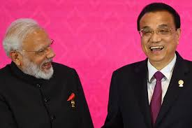
Effects on World Economy Cont…
The European Union is affected slightly by the RCEP agreement
However, these effects are not negligible and will be felt with time
From the standpoint of companies in Europe, the RCEP is a free trade agreement among three powerhouses; the Republic of Korea, Japan and China
Under the RCEP, China is committed to reducing tariffs on its exports by 86 percent, auto parts included (Nytimes.Com, 2020)
Notes:
The European Union is among the biggest trade agreement, however, due to rise of RCEP, more changes have been noticed in the union. RCEP creation is affecting the European union gradually, although the variations are not easily notable they should be considered as will be felt with time. Based on European nations viewpoint RCEP is a free trade agreement within three largest economies like Japan, the Republic of Korea and China. According to NYtimes.com (2020), China is determined to decrease tariffs on its exports for example auto parts by 86 percent.

Slide 13
Effects on World Economy Cont…
These powerhouses produced $5.3 trillion of worth-added in production in 2019, which is over a trillion higher than the EU and the US combined (Dadush & Darandary, 2020)
Additionally, RCEP allows for the outreach of over 675 million individuals far from Australia, ASEAN and New Zealand other than the population of Japan, China and the Republic of Korea (The Economist, 2020)
The biggest concern for the EU is its exports being displaced to RCEP signatories because of the preferred margins granted to the other members
This is commonly described as a trade diversion
Notes:
The integration of the three countries, China, Japan and the Republic of Korea are the biggest producers. According to Dadush & Darandary (2020), the three countries produced 5.3 trillion dollars' worth of productions in 2019. This indicated one trillion more than what the European Union and the United States when combined produce. Similarly, according to The Economist (2020), RCEP permitted the outreach of more than 675 million people far from Australia, New Zealand and ASEAN other than the population of China, Japan and the Republic of Korea. Trade diversion will happen because the European Union fears its exports displaced by RCEP members due to high variation provided.

Slide 14

Conclusion
The RCEP will be responsible for numerous shifts of companies due to the tariffs provided
This in turn will hurt major economic powerhouses especially those who are dissociated totally with the Pacific region
Those that are rigid to change such as the US may be significantly affected when the Pacific region takes over as the number one powerhouse economically
If the current trend continues, most companies will be forced to reduce prices or even shut down completely
Notes:
RCEP has significant effects on the global economy because it is responsible for companies changes in operation because of the tariffs provided. This will make RCEP member countries to benefit more while the non-members to benefit slightly. The major economic powerhouses not linked with the Pacific region and inflexible to transform will suffer economically such as the United States especially when the Pacific region takes over as the number one powerhouse. Also, other countries will develop because of a ready market for their products however if the present trend persists, many firms will be required to decrease their prices or shut down due to stiff competition from RCEP members.

Slide 15
References
Dadush, U., & Darandary, A. (2020). The Impact of the RCEP on the European Union. The ASEAN Post. https://theaseanpost.com/article/impact-rcep-european-union.
International Business. (2012). Chapter 7: Foreign Exchange and the Global Capital Markets. In International Business. https://saylordotorg.github.io/text_international-business/. Licensed under CC BY-NC-SA 3.0.
Kuo, M. (2020). RCEP: The Future of Trade in Asia. Thediplomat.com. https://thediplomat.com/2020/12/rcep-the-future-of-trade-in-asia/.
McDonald, T. (2020). What is the Regional Comprehensive Economic Partnership (RCEP)? BBC News. https://www.bbc.com/news/business-54899254.
Nytimes.com. (2020). China-Led Trade Pact Is Signed, in Challenge to U.S. https://www.nytimes.com/2020/11/15/business/china-trade-rcep.html.
The Economist. (2020). The Meaning of RCEP, the World’s Biggest Trade Agreement. https://www.economist.com/finance-and-economics/2020/11/15/the-meaning-of-rcep-the-worlds-biggest-trade-agreement.

